Slide 1
MWA Project Planning Name: Wesley Index No: 20 Class: S4-2
MWA Project Planning Name: Wesley Index No: 20 Class: S4-2
Read the instructions given in the box on every slide.
Complete the information in each slide
You can add more slides as needed

Slide 2
Project Theme
Project Theme
Instructions:
Clearly state the overall theme of your Adobe Animate project.
Example themes:
Fitness Fun
Interactive Sports Challenge
Product Showcase
Educational Game
Theme name: Skating to the end and score points.

Slide 3
Project Purpose
Project Purpose
Instructions:
Describe the purpose of your project.
Specify whether it's to:
Promote a sports event.
Advertise a new gym.
Promote a new product.
Create a simple game.
Or another clearly defined purpose.
Explain why you chose this particular purpose.
Purpose of the project: To let people learn the basics of skateboarding.
Type of project: Create a simple game based on skateboarding to the finish line using coins or points.
Why this purpose was chosen: It’s chosen because to let people who is interested in skateboarding to learn how to ride skateboard safely and the basic techniques of skateboarding. It also teaches people to learn skateboarding confidently.

Slide 4
Animation Description
Animation Description
Instructions:
Provide a detailed description of the animation you plan to create.
Describe the sequence of events, key movements, and overall style.
What will the user see happen on the screen?
Will it be a looping animation, or one that has a defined end?
Animation overview: A skateboarding rides forward, collecting points on the way to the finish line.
Sequence & movements: The skateboarder starts from the rights, skate from one end to another end, together with player 2.
Visual style: Bright, simple, and cartoon-like for easy understanding.
Ending: The animation ends at the finish line but can loop again if click on the restart button and the start button again.

Slide 5
Opening Page Sketch
Opening Page Sketch
Instructions:
Create a rough sketch of your project's opening page.
Include:
Layout of visual elements.
Placement of buttons (e.g., "Start," "About," "Instructions").
If there will be a website link, show the location.
Label each element.
This can be a hand drawn sketch that is inserted into this slide
Opening Page
Game title name: XXX → this page at intro.
Restart Button
Start Button
Website Button
Scoring: 000
Skateboarder center of the screen. (Player 1 and Player 2)
Labels:
Top: Game name and Instructions. (Intro Page)
Middle: Skateboarder Character (Player 1 and Player 2)
Bottom: Play button, Website button, Music button and Start button.

Slide 6
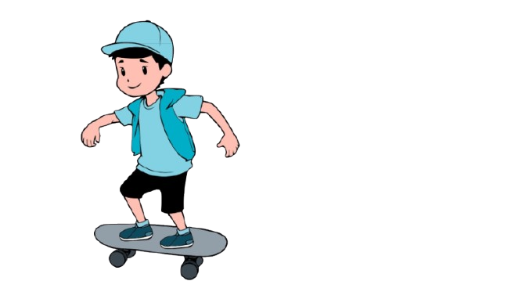
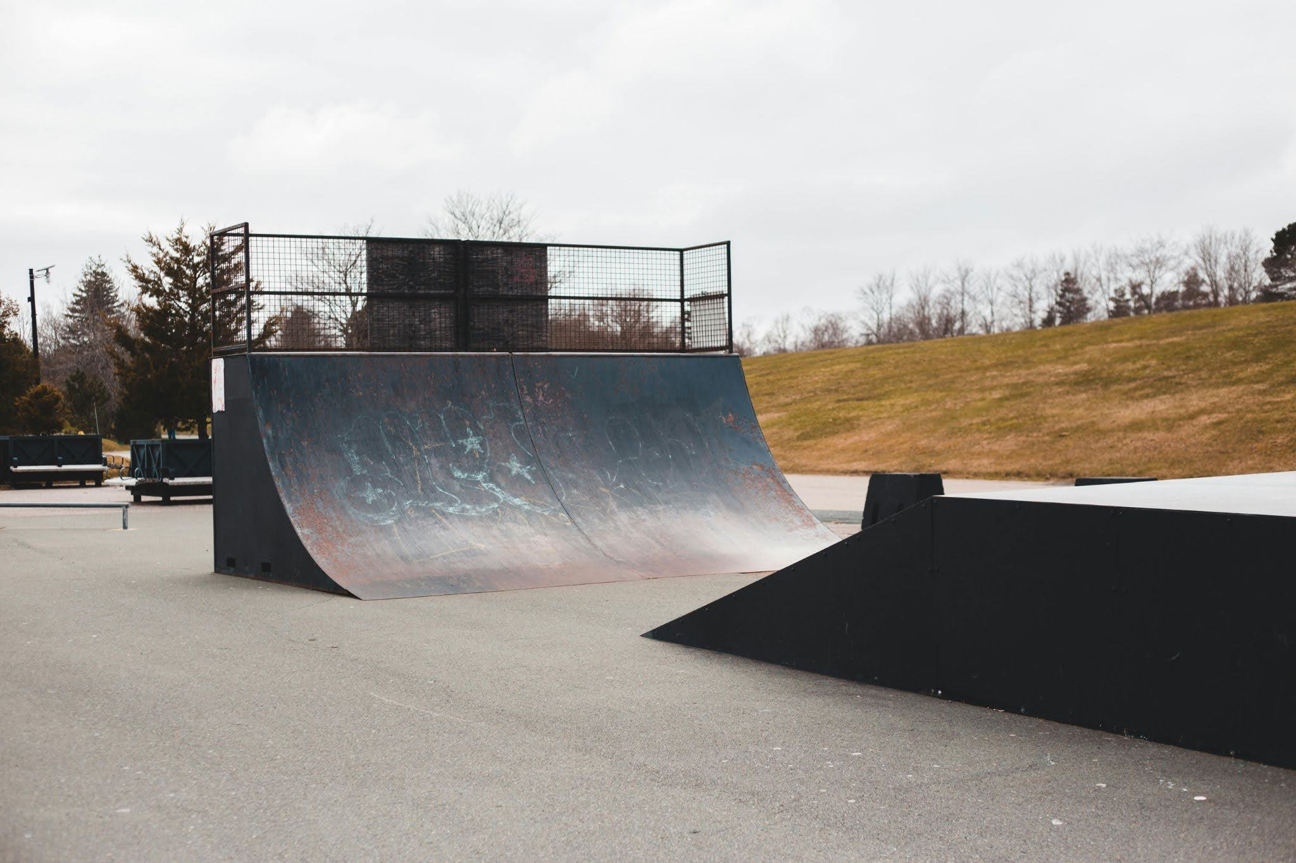
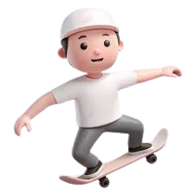
Opening Page Sketch
Opening Page Sketch
Instructions:
Create a rough sketch of your project's opening page.
Include:
Layout of visual elements.
Placement of buttons (e.g., "Start," "About," "Instructions").
If there will be a website link, show the location.
Label each element.
This can be a hand drawn sketch that is inserted into this slide
Image at the side are the characters and background that I’m using in my animation
Player 1
Player 2

Slide 7
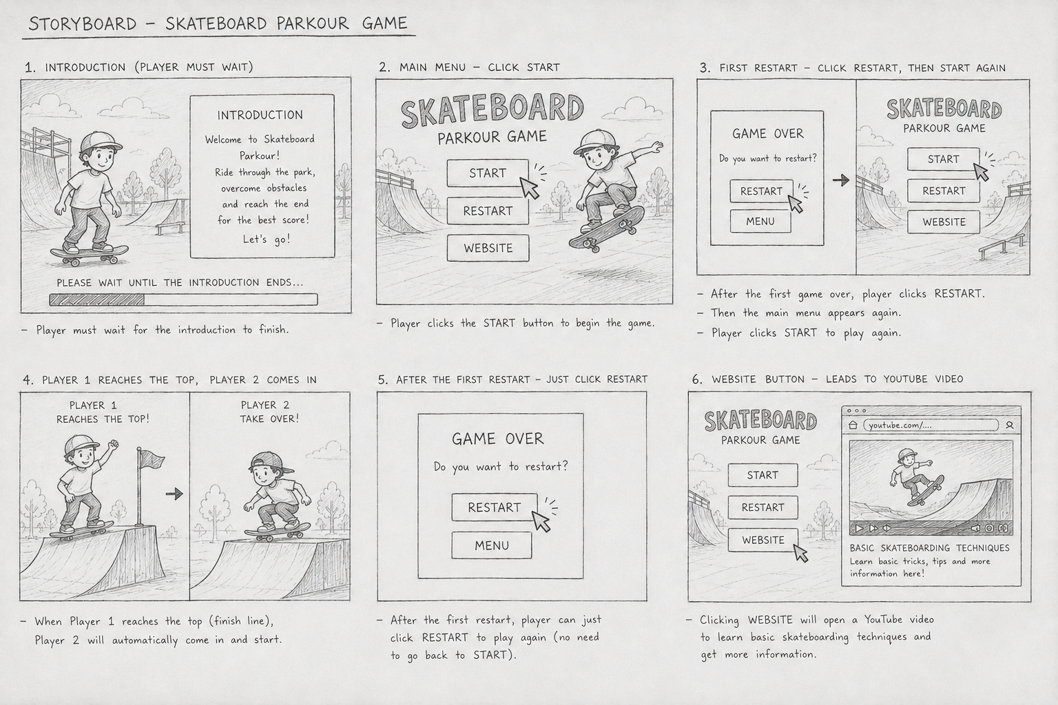
Content Page Sketch
Content Page Sketch
Instructions: Add more slides if you have many contents
Create a rough sketch of a representative content page.
Include:
Layout of content (text, images, interactive elements).
Placement of "Return" or navigation buttons.
How the user navigates through the content.
Label each element.
This can be a hand drawn sketch that is inserted into this slide

Slide 8

Image Identification
Image Identification
Instructions:
List all the images you plan to use in your animation.
Identify:
Characters.
Backgrounds.
Props.
Any other visual elements.
Where will the images come from? Original art, stock images, etc.
Characters: One to Two Skateboarders (player 1 and player 2)
Visual Elements:
Image: AI (ChatGPT and Meta AI) and Google (Pixabay)
Background image at the side of the slides.
Sound/Music: Google (pixabay)
Music/sound is below the background image.

Slide 9
Image Attribution
Image Attribution
Instructions:
If you are using images from external sources (e.g., stock photo websites, Creative Commons), provide proper attribution.
Examples:
Stock Photo: "Image: [Image Title] by [Artist Name] from [Website Name].
"Creative Commons: "Image: [Image Title] by [Artist Name] (CC BY-SA [Version Number]) from [Website Name].“
If the image is public domain, state that.
Provide the direct URL of the image source if possible.
If all images are original, state "All images are original works."
Image Source:
https://www.meta.ai/prompt/b2595829-a6fc-42c1-bc08-daa674ce6d7a
Ihttps://pixabay.com//?utm_source=link-attribution&utm_medium=referral&utm_campaign=image&utm_content=8483739
Skateboarding Music Source:
Skateboard Sound Effect → This is a link.
→ Sound effects is the effects that I have chosen

Slide 10
Lead up to Project Theme Selection
Lead up to Project Theme Selection
Ask yourself | Pen down your thoughts
What is the theme of your Project? | Skating to the end and score points
What is the purpose of your animation? | To let people who are interested in skateboarding to encourage them to learn and learn the basic techniques.
What is the story that you want to tell? | Don’t be afraid of learning skateboard, it will be hard at first. But once you learn used to it, it will be easy for you.

Slide 11
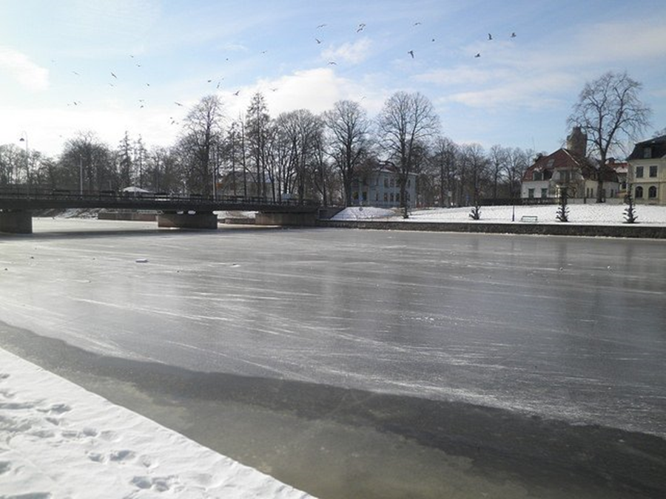
Attributing Images Example
Attributing Images Example
Authors | Title | Source (e.g. Websites) | Licence
David J, | Winter in town | https://www.pixsy.com/image-licensing/correctly-attribute-images | CC BY 2.0

Slide 12
Project timeline
Project timeline
Period | Tasks | Status
Week 1 | Theme Selection
Week 2 | Source file is created and published in the required format
Week 3 | Media are used and integrated; also comply with copyright rules
Week 4 | Intro Animation is created based on project requirement
Week 5 | Intro Animation is created based on project requirement
Week 6 | Restart Button and 2 interaction buttons are created
Week 7 | Code is applied to user interaction component based on requirement – e.g. stop the animation; go to frame and play
Week 8 | Comments are written to explain the code
Week 9 | Test your animation on browser and refine your animation
Week 10 | What can be further improved?

Slide 13
Past Examples
https://sss.joycegsy.com/PeiEn/
https://sss.joycegsy.com/HongTing/
https://sss.joycegsy.com/Ezra/
https://sss.joycegsy.com/Aqmal/
https://the-king-12.github.io
https://sss.joycegsy.com/Joanna/
https://sss.joycegsy.com/Emberlyn/
https://sss.joycegsy.com/Estelle/
https://sss.joycegsy.com/Mukhriz/
https://sss.joycegsy.com/Zavier/

